Slide 1

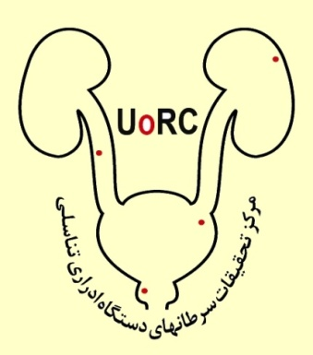
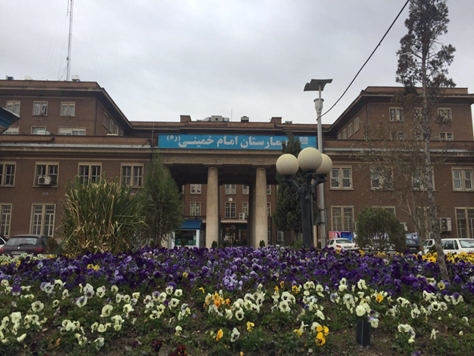
Management of Post radical prostatectomy Urinary incontinence
S.A.Momeni M.D
Assistant Professor of Urology
Fellowship of Uro-oncology
Tehran University of Medical Sciences

Slide 2
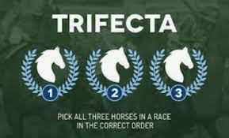
Trifecta:
Cancer control.
Urinary continence.
Sexual function (Potency).

Slide 3
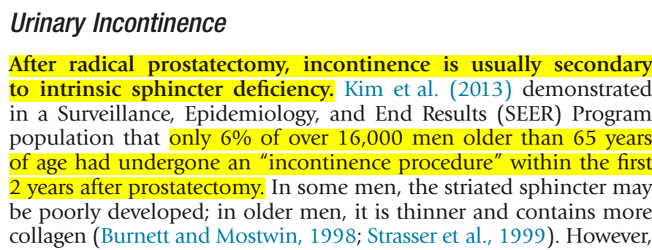
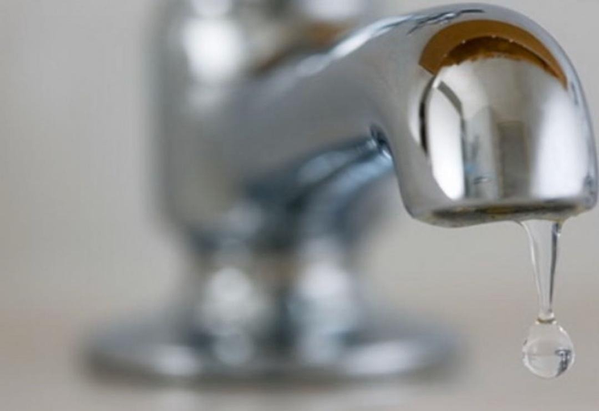
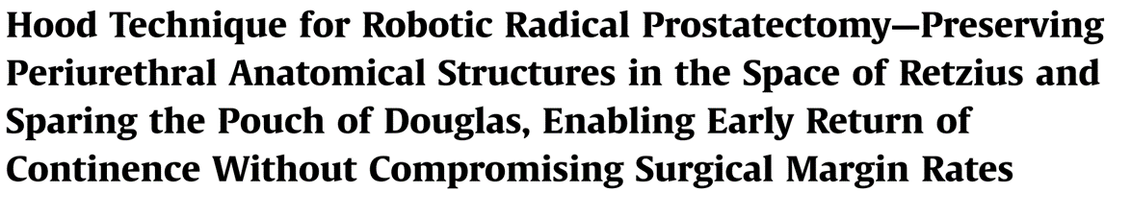
Urinary Incontinence:

Slide 4
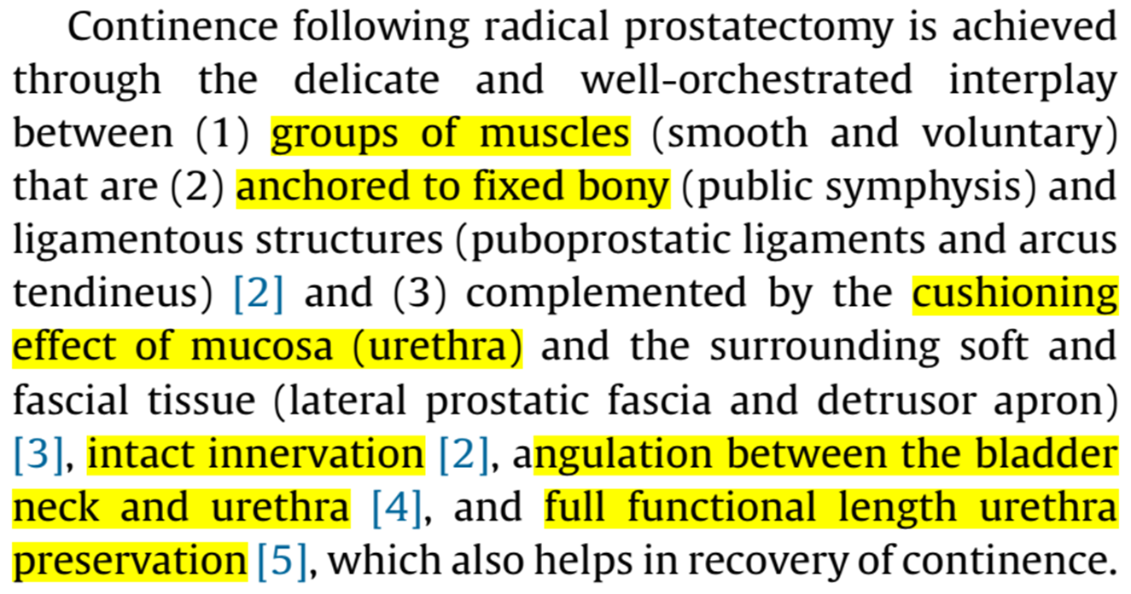

Slide 5
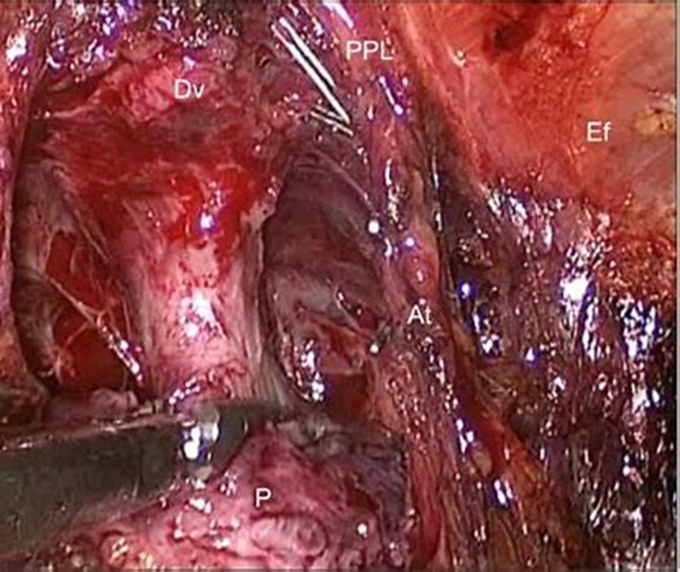
Modifications:
Modifications in apical dissection
to maximize urethral length

Slide 6
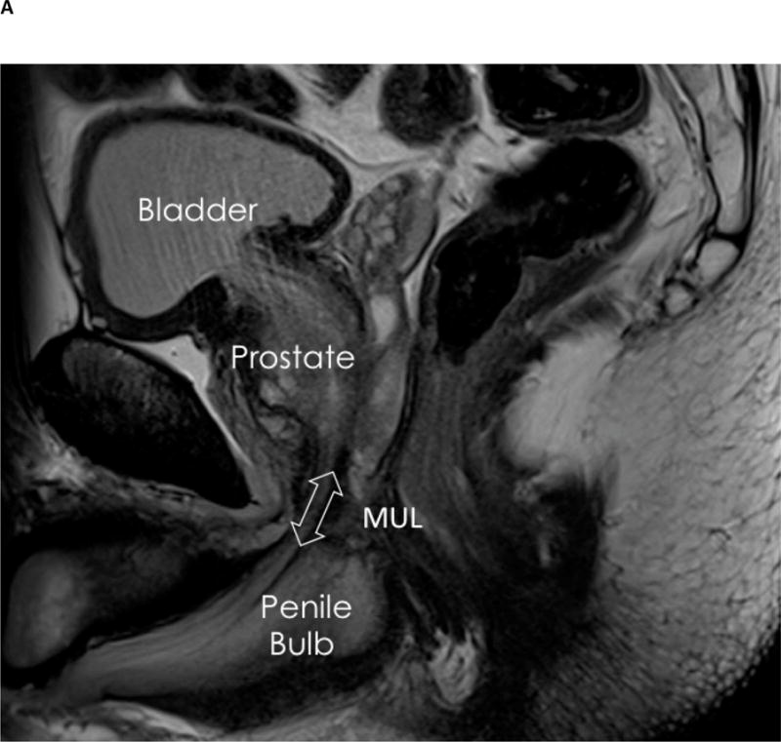
Urethral length preservation:
Overall for every extra millimeter of MUL the estimated odds of continence recovery is increased by between 5% and 15%.
MUL measurements:
The MUL : range from 10.4 mm to 14.5 mm
Eur Urol. 2017 Mar; 71(3): 368–378.

Slide 7
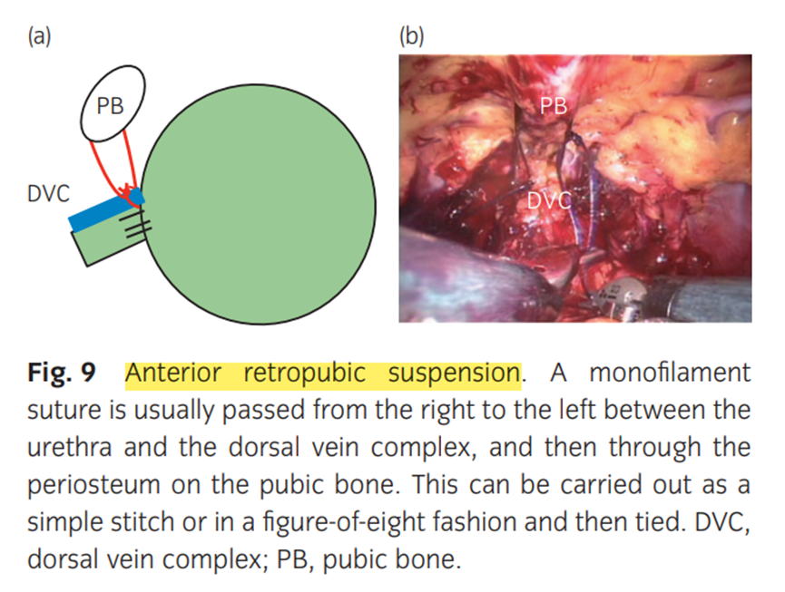
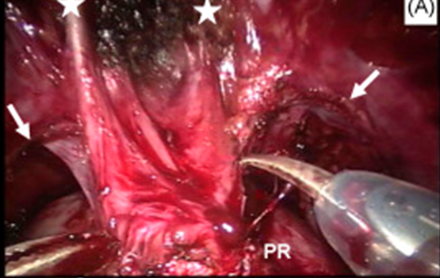
Modifications:

Slide 8
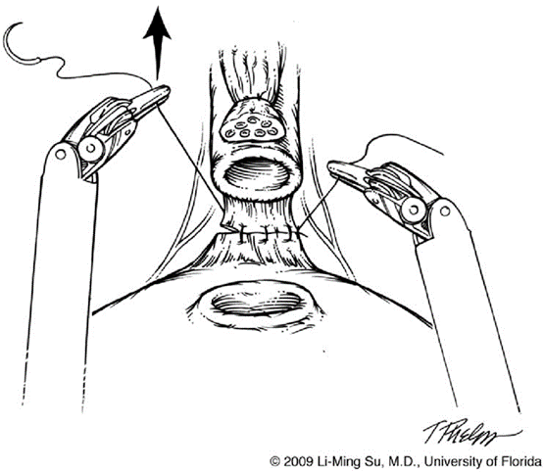
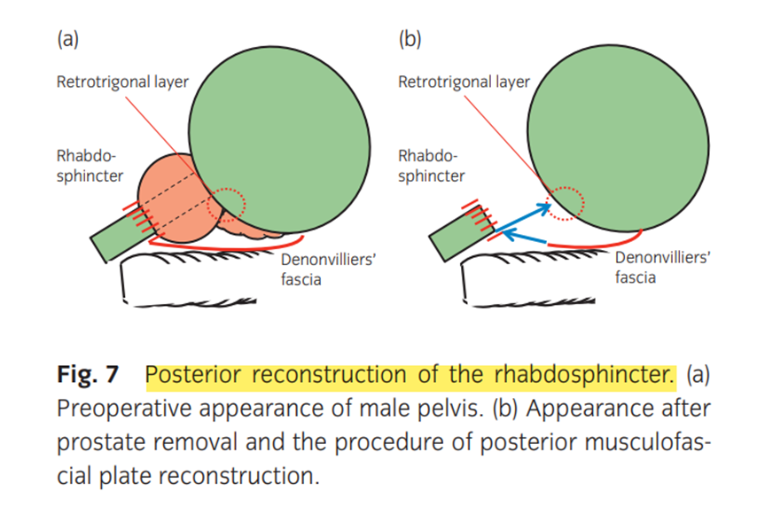
Modifications:

Slide 9
As there is conflicting evidence on the effect of anterior and/or posterior reconstruction on return to continence post-RP, no recommendations can be made.

Slide 10
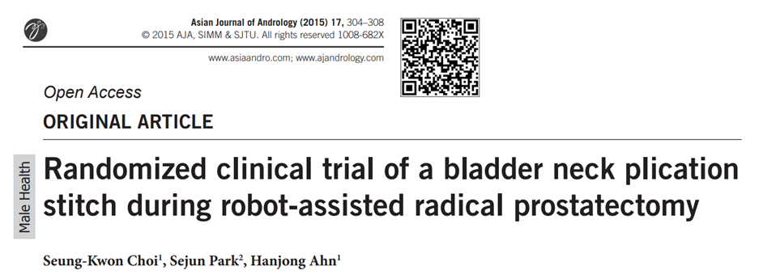
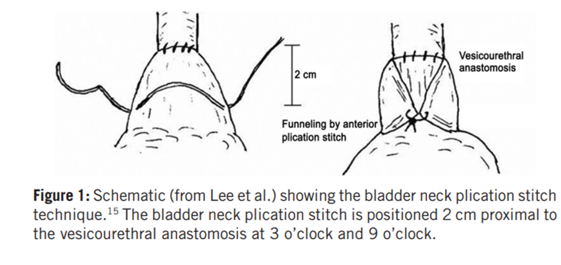
Bladder neck plication:

Slide 11
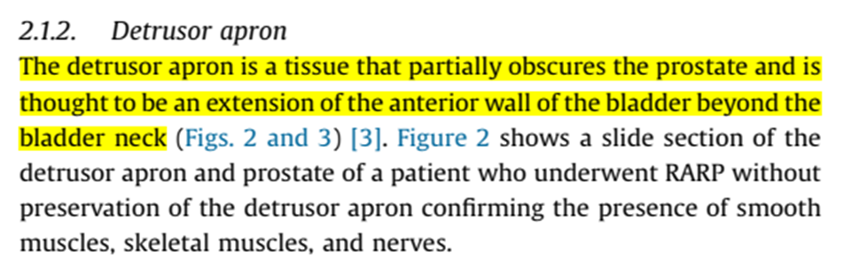
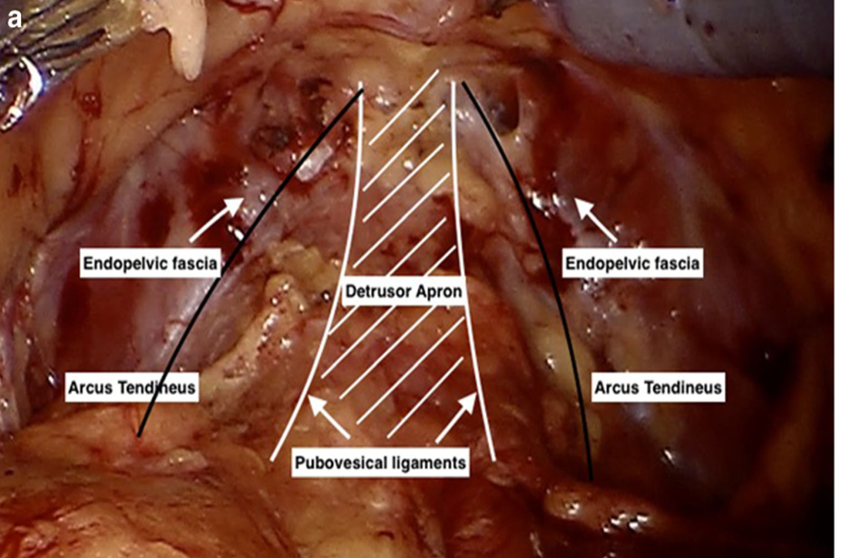
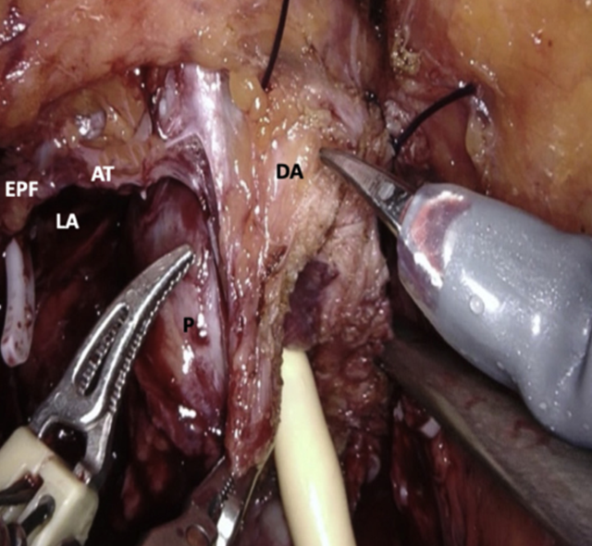

Slide 12
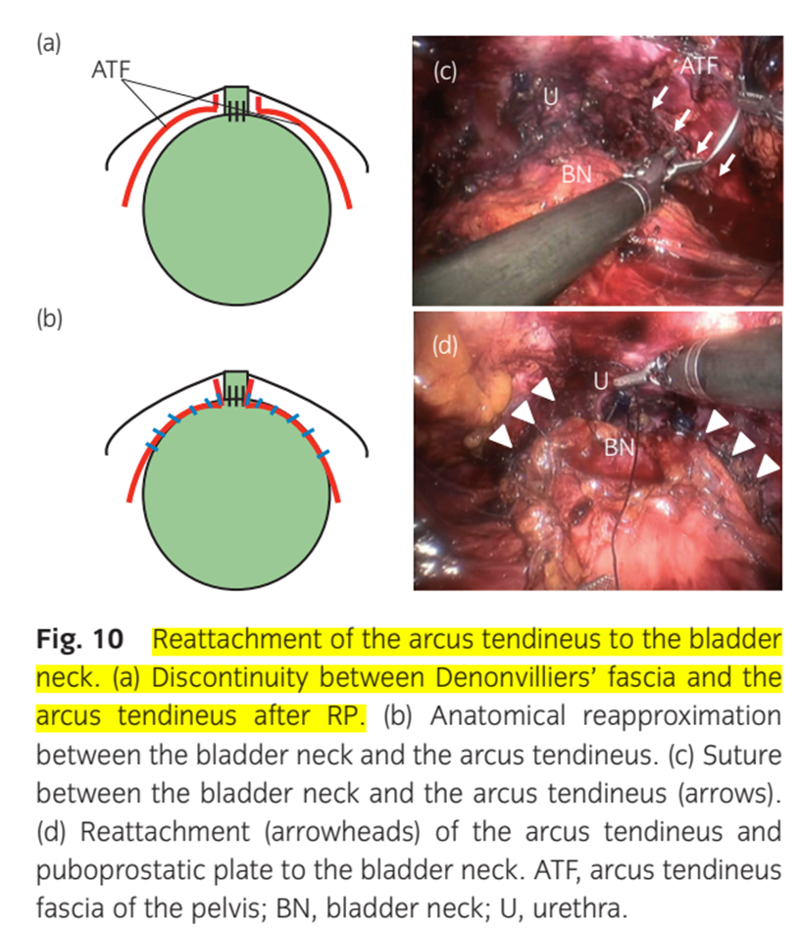
Reattachment of the arcus tendineus to the bladder neck

Slide 13
Striated sphincter may be poorly developed, it is thinner and contains more collagen .
The smooth musculature of the urethra, which also contributes to continence, can be:
Damaged by placement of large deep sutures for the anastomosis.
Denervated by injury to the NVBs.
Urinary continence can be hampered by bladder neck contracture or a wide bladder neck.

Slide 14
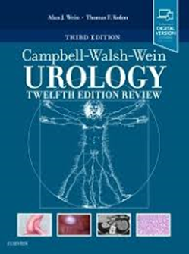
To avoid these complications:
Preserve the striated sphincter during the apical dissection.
Avoid tension on the final anastomosis.
Reconstruct the bladder neck so that the opening is small and supple.
Accomplish a precise mucosa-to-mucosa anastomosis.
Its important to avoid excessive traction on the bladder intraoperatively.

Slide 15
Bladder neck preservation:
Preservation of the bladder neck has therefore been proposed to improve continence recovery post-RP(in both the short- and long-term).
Mean base-specific positive margin rate of 4.9% with bladder neck preservation vs. only 1.9% without .
Bladder neck preservation should be performed routinely when the cancer is distant from the base.
Bladder neck preservation, however, cannot be performed in the presence of a large median lobe, or a previous TURP.

Slide 16
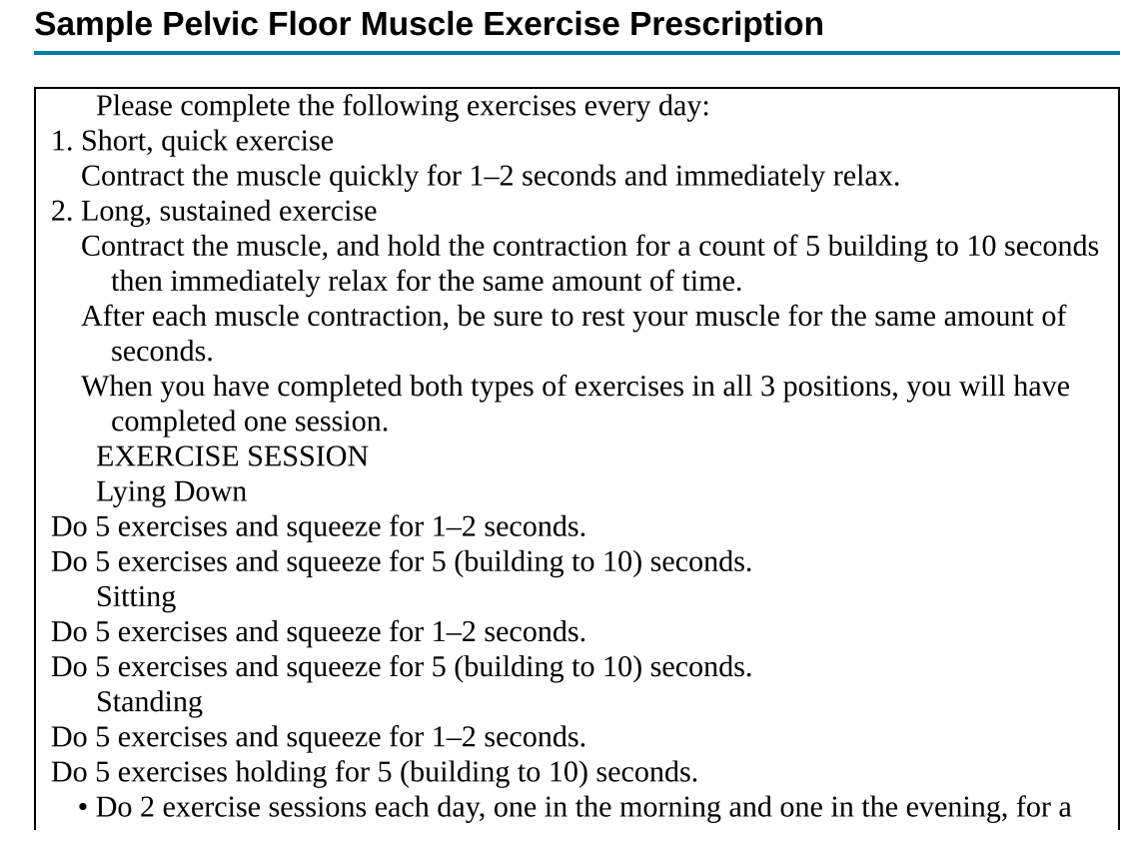
Pelvic floor muscle training :

Slide 17
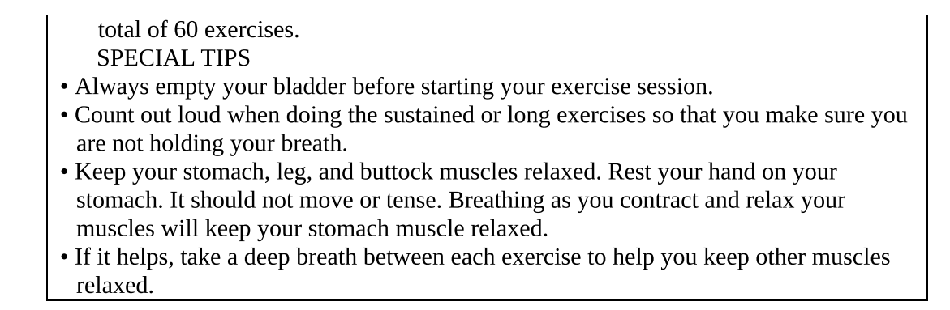
After 8 weeks of treatment, men in the behavioral training group showed 55% reduction in UI episodes, significantly greater than the 24% reduction in the control group, and improvements were sustained to 12 months.

Slide 18
EAU 2023

Slide 19
Stress Urinary Incontinence:
Weight loss and lifestyle changes:
Patients are advised to reduce their fluid intake, avoid caffeinated beverages and alcohol.
Bladder training

Slide 20
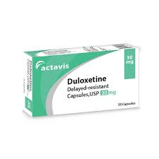
Drugs:
Stop α-adrenergic antagonists if they take them for the treatment of hypertension.
Treatment with Imipramine in men who are not hypertensive can be helpful.
Duloxetine (off-license): combination of norepinephrine and serotonin reuptake inhibitor

Slide 21
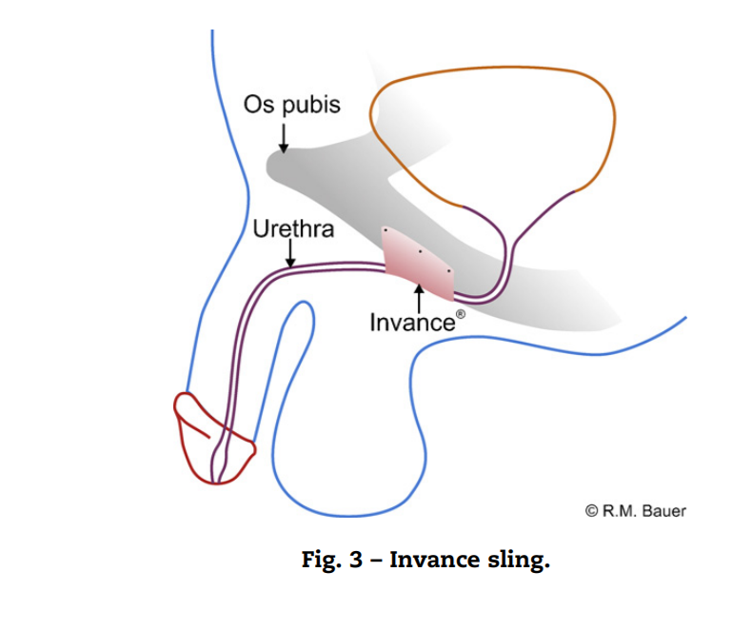
Invance male
Bone-anchored sling systems

Slide 22
Advance male
Functional retro-urethral sling

Slide 23
Male Suburethral Sling (fixed or adjustable)

Slide 24
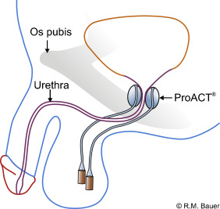
ProACT balloon:

Slide 25
The ProACT device consists of a compressive balloon system that is placed in the bladder neck area, and volume can be readjusted via two scrotal ports with continence success rates of up to 68%.
Explantation rates of up to 55%.

Slide 26
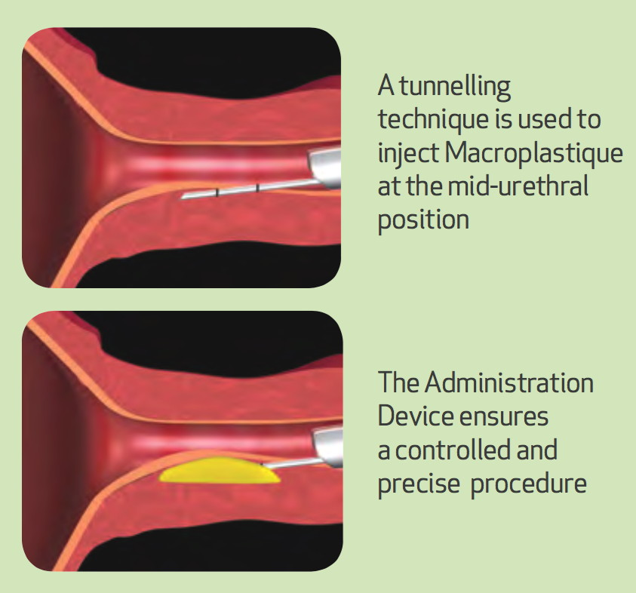
Bulking agent:

Slide 27
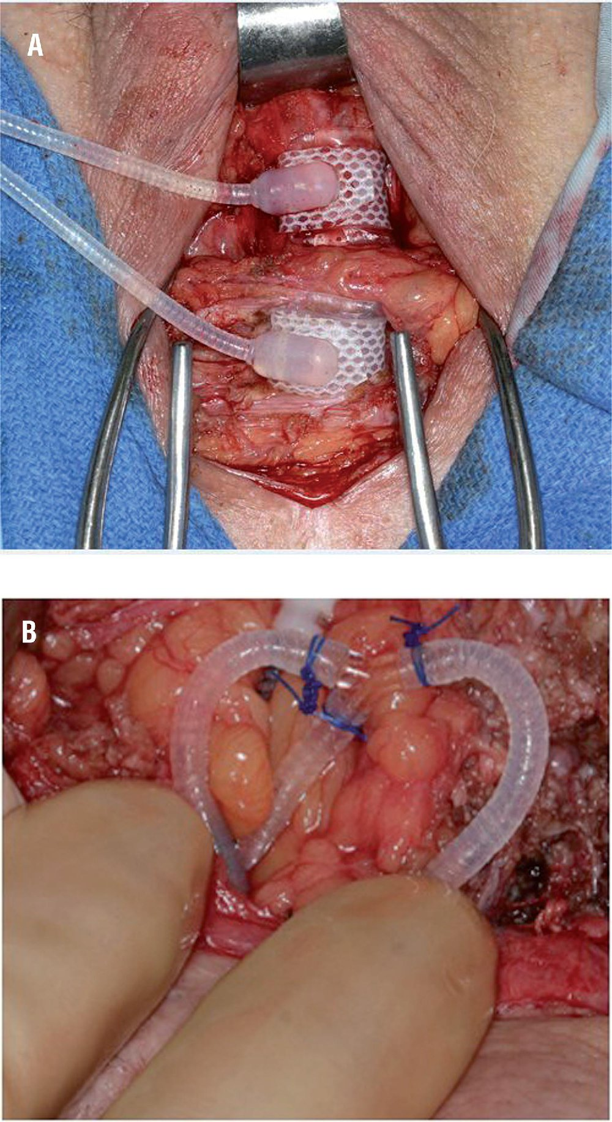
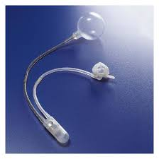
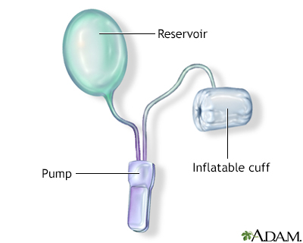
AUS (Gold standard):

Slide 28
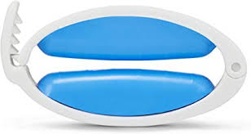
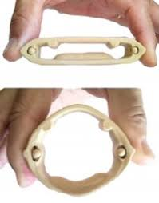
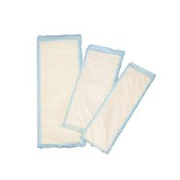
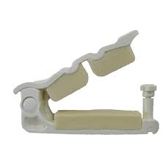
Penile clamp
Condom catheter.
Urethral (not recommended long term because of risk of traumatic hypospadias)
Suprapubic catheter
Incontinence pads.

Slide 29
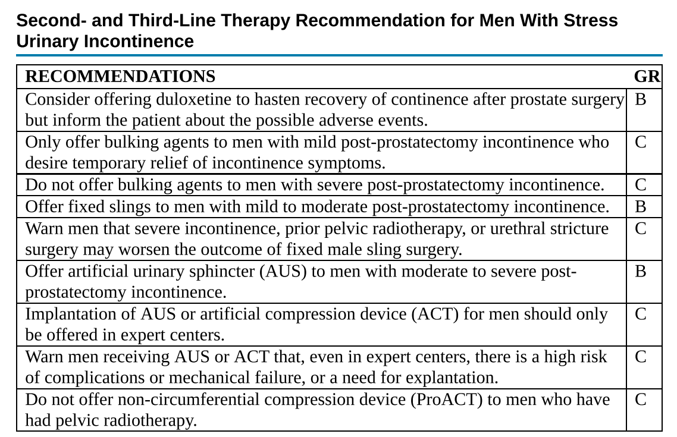

Slide 30
Urgency Urinary Incontinence:
Fluid manipulation and lifestyle changes:
Reducing fluid input by 25% as long as the patient is drinking more than 1 L/day.
Stopping smoking.
Reducing weight.
Avoiding caffeinated and fizzy drinks.

Slide 31
Bladder training and pelvic floor muscle training:
These treatments must be attempted for at least 6 weeks to obtain benefit, and they should ideally be tried for 3 months.

Slide 32
Antimuscarinics and/or β3 agonists:
At least two antimuscarinics were recommended to be tried for at least 4 weeks each.
Solifenacin may be preferred over tolterodine
The combination of two antimuscarinics or doubling the recommended dose of some antimuscarinics could be an option in selected patients to increase efficacy.

Slide 33
Mirabegron, which is a β3-agonist lipophilic medication that is metabolized in liver, and more than 50% is excreted in the urine.
Combination therapy of an antimuscarinic with a β3-agonist has been shown to be an effective modality of treatment.
Mirabegron 50 mg with solifenacin 5 mg.

Slide 34

PDE-5 inhibitors have been shown to improve LUTS and UI in men .
They relax the smooth muscles of the prostate, bladder, and urethra and improve bladder blood flow, which ultimately improves the patient's symptoms.
Tadalafil is the only FDA approved PDE-5 inhibitor.

Slide 35
Botulinum toxin:
Botox, ona-botulinum toxin A, is the only licensed formulation of
Botulinum toxin A, for idiopathic UUI at 100 units, and for neurogenic DO at 200 units.
The risk of urinary retention (approximately 10%).
They should be able and willing to perform intermittent catheterization.
The injections must be repeated on average every 6 to 9 months.

Slide 36
SNM
Test phase with a wire and external stimulator for 1 to 2 weeks.
If more than a 50% improvement in symptoms.
Permanent tined lead with a longer test phase for 2 to 4 weeks that is placed percutaneously under fluoroscopy in the S3 sacral foramen alongside the sacral nerve.
The cure rate of UUI is 39%, and an improvement of greater than 50% is seen in 67% of patients.

Slide 37
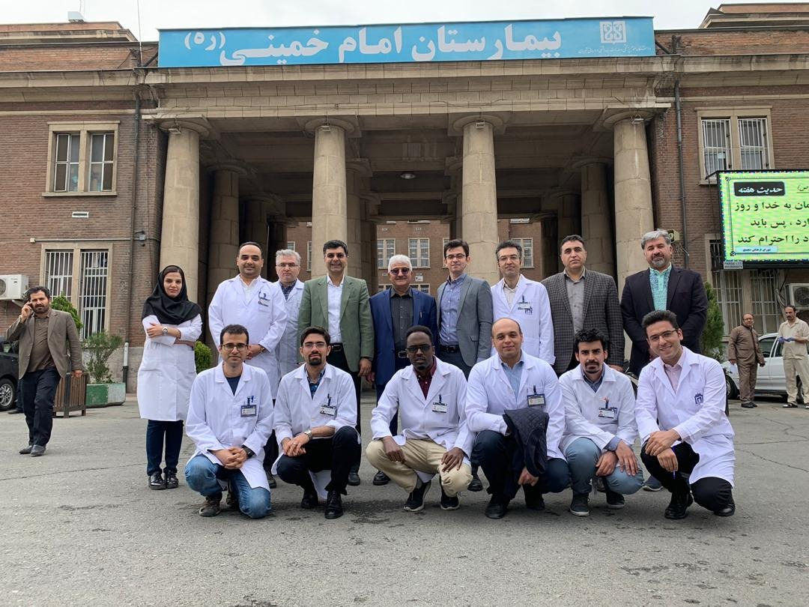
Thank you for your attention

