Slide 1
Medical Management in Patients with BPO
Erfan Amini M.D.

Slide 2
BPH or BPE or BPO?

Slide 3
a-Blockers
a-Blockers are often considered the first line of pharmacotherapy for BPH-LUTS.
Rapidly relieve LUTS by interrupting the stimulation of a-adrenoceptors located on the smooth muscle in either the neck of the bladder, the prostate, or the prostatic urethra.
EAU Guideline 2022

Slide 4
Different a-Blockers
Silodosin,
Alfuzosin,
Doxazosin,
Terazosin,
Tamsulosin

Slide 5
Comparisons between different a-blockers
RCT
Comparing the effectiveness of silodosin 8 mg, tamsulosin 0.4 mg, and a placebo among 1228 men in an RCT

Slide 6
Both silodosin and tamsulosin were equally effective
Silodosin (highly selective for a-1A andrenoceptor subtype over subtype 1B) is thought to have a minimal prevalence for cardiovascular adverse events, but higher incidence of ejaculatory dysfunction.

Slide 7
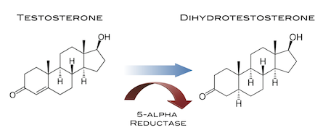
5-a-Reductase Inhibitors
Normal development, the growth of the prostate is regulated by the conversion of testosterone to dihydrotestosterone (DHT) by 5-a-reductase (5-AR) existing as type 1 and type 2.

Slide 8
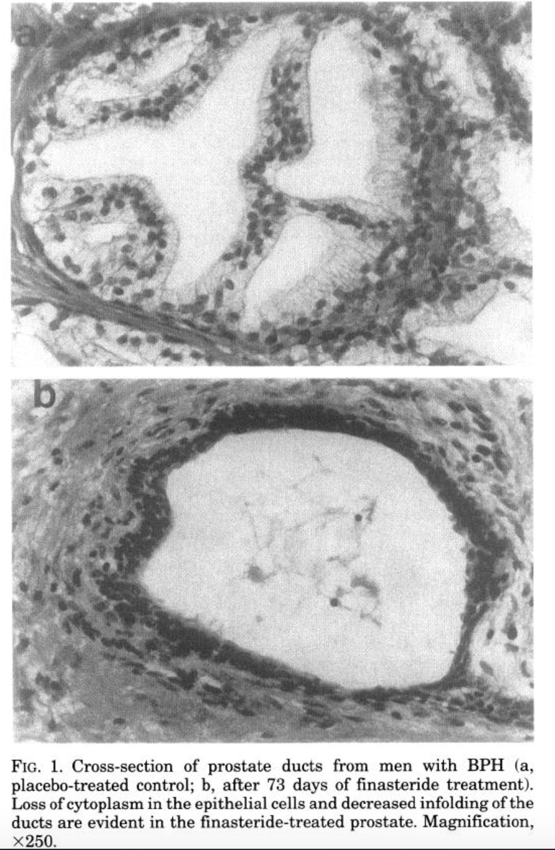
5-a-Reductase Inhibitors

Slide 9
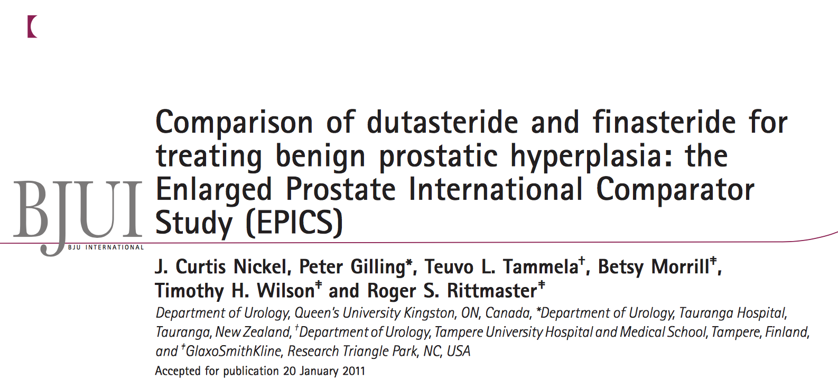
Dutasteride vs. Finasteride
Enlarged Prostate International Comparator Study (EPICS):
Multicenter randomized double-blind study of 1630 men>50y.
Both therapies were comparably effective in $↑$Qmax, $↓$prostatic volume and symptoms in men with BPH when administered over a 12-month period

Slide 10
Dutasteride vs. Finasteride

Slide 11
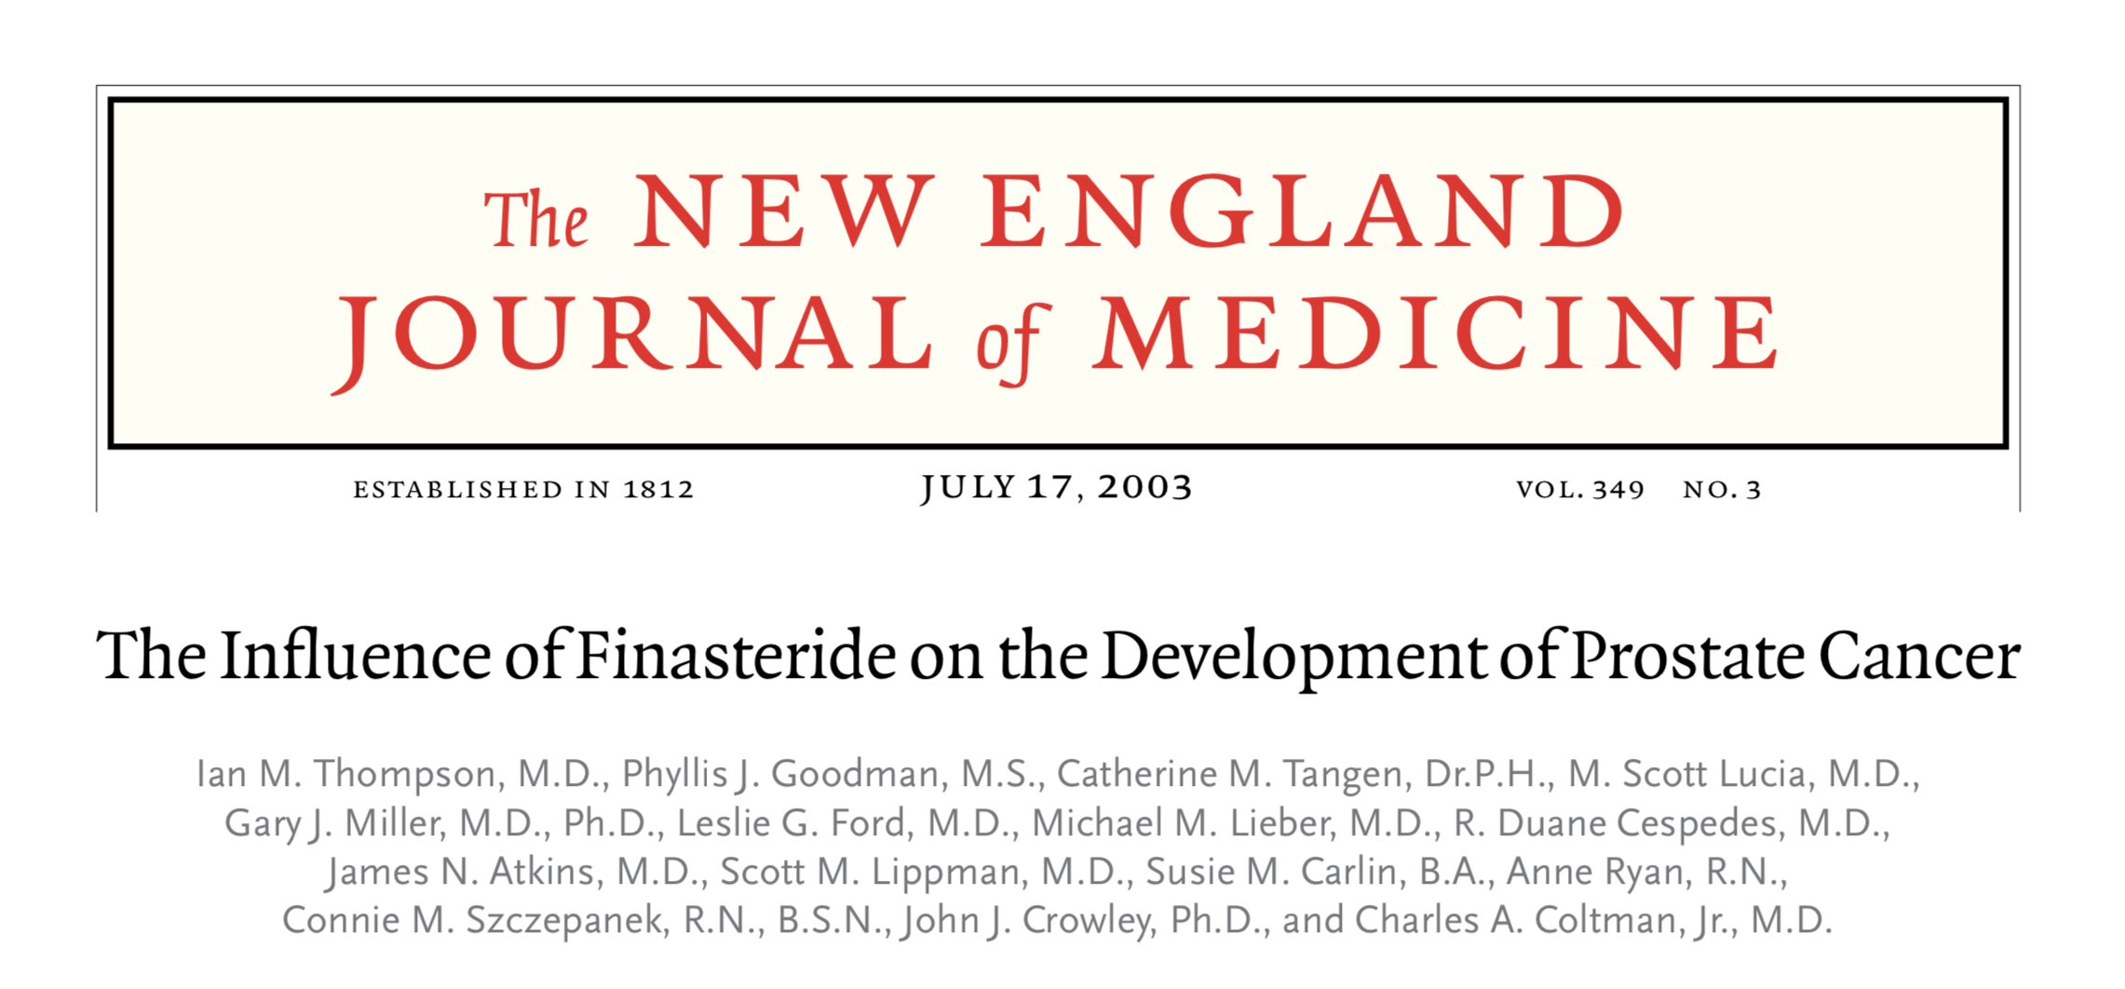
Men taking 5-ARIs should be followed-up regularly using serial PSA testing and any confirmed PSA increase should be evaluated accordingly.

Slide 12
EAU Guideline 2022

Slide 13
Antimuscarinic

Slide 14
EAU Guideline 2022

Slide 15
PDE5-Inhibitors
These agents work to increase intracellular levels of cGMP, which in turn reduce detrusor, prostate, and urethra smooth muscle tone.
Chronic treatment with PDE5Is seems to increase blood perfusion and oxygenation in the LUT.
PDE5Is could reduce chronic inflammation in the prostate and bladder
Morelli A, et al. J Sex Med, 2011. 8: 2746.

Slide 16
PDE5-Inhibitors
Clinical studies have demonstrated that the use of either of these PDE5-Is can have significant improvements in LUTS in men with BPH.
Clinical trials have not showed any meaningful changes in outlet obstruction such as PVR volume.

Slide 17
Combination of PDE5-Inhibitors + 5-a-Reductase Inhibitors

Slide 18
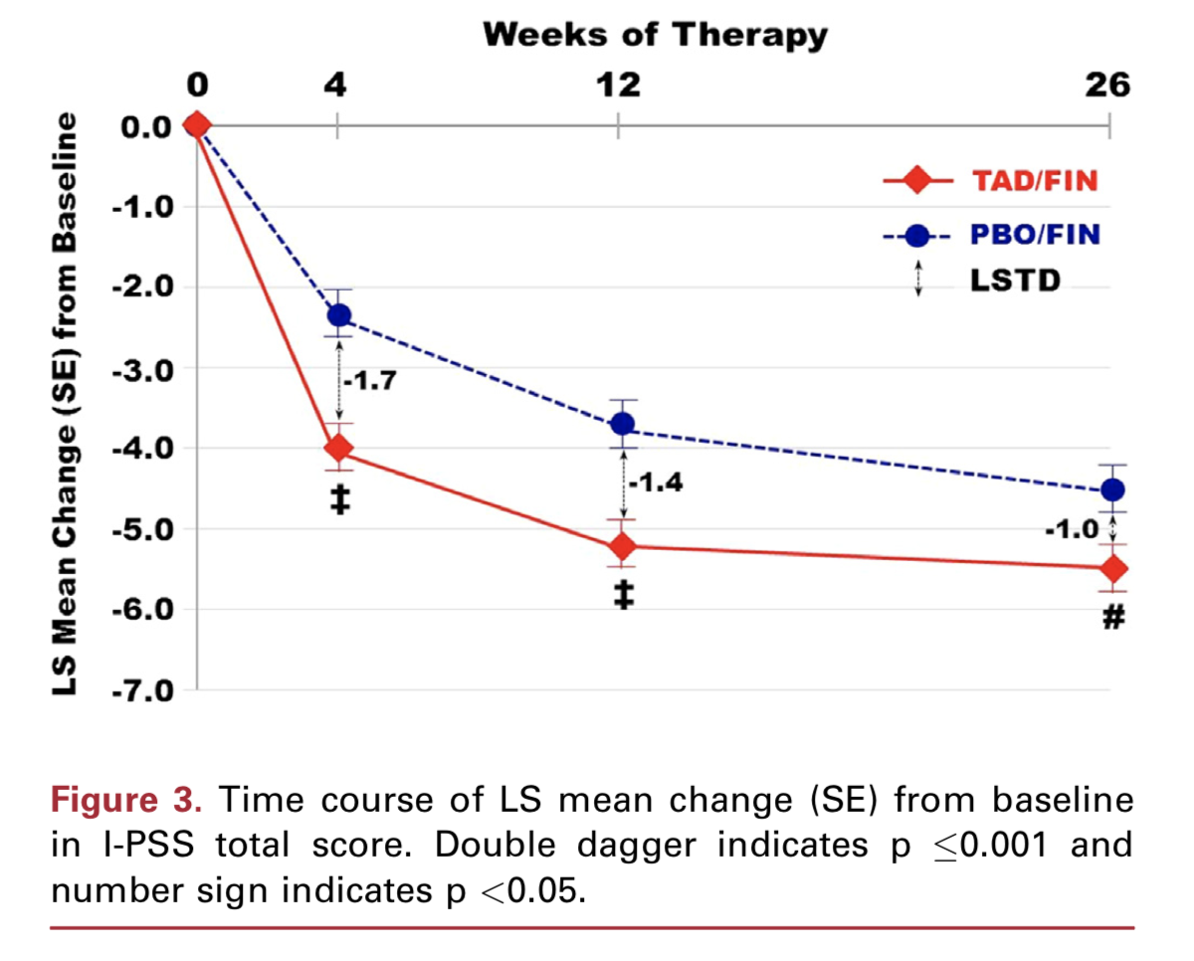
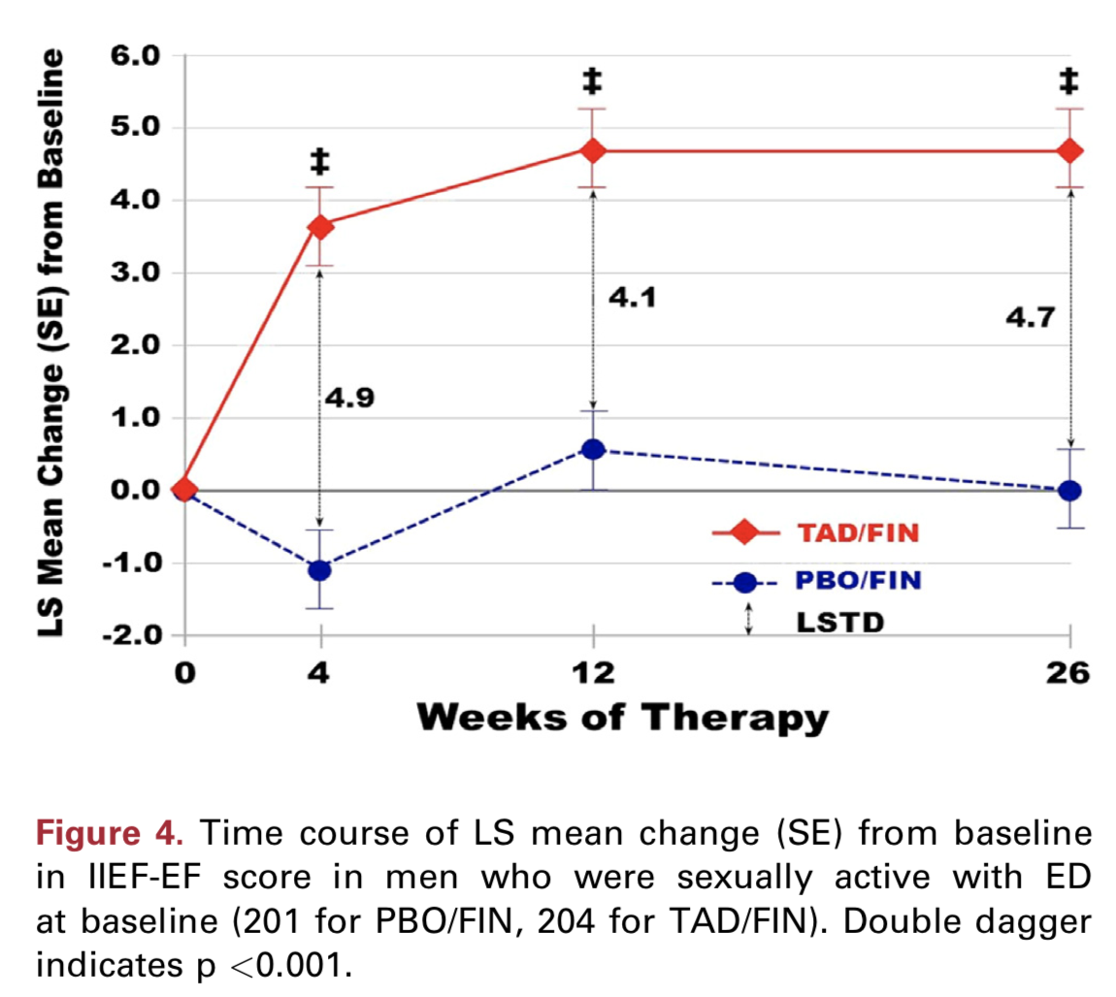
The effects of tadalafil 5 mg combined with finasteride 5 mg were assessed in a 26-week placebo-controlled RCT.
The combination of tadalafil and finasteride provided an early improvement in urinary symptoms and QoL.
Combination therapy was well tolerated and improved erectile function

Slide 20
Thanks for Your Attention

