Slide 1
dr Shahla Noori Ardebili MD
Advance laparoscopic surgeon from World Laparoscopy Hospital (DELHI ) Atieh Hospital
2025

Slide 2
Cesarean Scar Pregnancy: Role of Minimally Invasive Surgical Techniques

Slide 3
Introduction
Cesarean scar pregnancy (CSP) occurs when an early pregnancy implants on the cesarean scar defect (CSD), myometrial tissue previously disrupted by cesarean delivery
terated with subsequent revision of the previous surgical site.[1] The incidence of CSP is increasing due to the rising number of primary CSs and decline in vaginal deliveries after previous CS and now accounts for 6.1% of all “ectopic” pregnancies.

Slide 4
Pathogenesis: Cesarean Scar Decect
The scar defect is typically located at the lower anterior uterine wall in the case of previous lower segment CS.
This is where incomplete healing of tissue cut at operation results in thinning or even dehiscence of the remaining myometrium.

Slide 5
CSD can be defined in terms of depth, residual myometrial thickness(RMT), and adjacent myometrial thickness(AMT). When the depth is more than 2 mm or RMT is <5 mm the defect is known as a niche. A large CSD is a defect with a 50%–80% reduction in wall thickness compared to the AMT or if the RMT is <2.2 mm by transvaginal ultrasound (TVUS) or <2.5 mm byhysterosalpingogram.

Slide 6
CSD formation has been associated with several perioperative factors:
the level of uterine incision indication for CS duration of labor and cervical dilatation before CS closure technique adhesions retroverted uterus

Slide 7
Classicication Cesarean Scar Pregnancy
CSP was classified into three types (I, II, and III) based on the relationship between the gestation sac and previous CS scar site as determined by ultrasound
A type I (or endogenic) CSP implants on the
scar and grows inwards
types II or III (exogenic) CSPs implant deep in a well vascularised CSD with an overlying RMT <3 mm and grow out towards the abdominal cavity.

Slide 8
Cesarean Scar Pregnancy‑in the Niche and on the Scar
“On the scar” implantations have a measurable myometrial thickness between the conceptus and anterior uterine surface and bladder and generally better outcomes
“in the niche” implantations which are intimately related to
the anterior uterine surface close to the bladder with minimal
if any, intervening myometrium

Slide 9
asymptomatic and diagnosed incidentally
during a routine first‑trimester ultrasound
clinical presentation
The most frequent
symptom is light, painless vaginal bleeding
Clinical
examination is often unremarkable
mild lower abdominal pain and tenderness

Slide 10
Diagnosis oc Cesarean Scar Pregnancy
TVUS usually provides a reliable diagnosis without the need for additional imaging.
Magnetic resonance imaging can aid preoperative planning for surgical intervention by
indicating the depth of myometrial invasion and any bladder involvement.

Slide 11
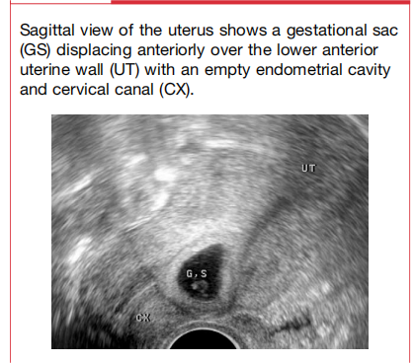

Slide 12
Expectant management
Expectant management of a CSP has been described but carries a high risk of major complications especially if a fetal cardiac activity is present.
Live births were achieved at 73% but the hysterectomy rate was 70%.
Imaging features may indicate pregnancies more suitable for this approach for women with a viable CSP who wish to continue.
Findings favoring a better outcome include an endogenic type CSP, COS‑2 on ultrasound and an RMT >3 mm.

Slide 13
Termination of cesarean scar pregnancy
medically (nonsurgically)
methotrexate (MTX),
direct local embryocidal injection into the sac with concomitant sac aspiration,
uterine artery embolization (UAE) and high‑intensity focused ultrasound
therapy (HIFU).
s u r g i c a l l y
laparoscopy,
laparotomy,
hysteroscopy and
curettage, and gestational sac suction evacuation.

Slide 15
the most effective method with the lowest complication rates and allows simultaneous scar repair hysteroscopy can help
Multilayer repair has a lower risk of wedge defect formation and uterine rupture improving the success rate with minimal impact on subsequent fertility.
Blood loss reduced .
The bladder is dissected free from the uterus, and CSD is excised along with pregnancy followed by repair of the defect.
Laparoscopy‑cesarean scar pregnancy

Slide 16
how do it perform?
CO2 pneumoperitoneum
conventional techniques
adhesiolysis
vesico-uterine fold was dissected,
Using monopolar energy or cold scissors,
deficient uterine scar was excised “en
bloc”
The myometrial
incision was systematically performed at 3–4 mm from the distal and proximal parts
of the gestational sac.
The cesarean scar was completely opened
A Hegar probe was inserted into the cervix

Slide 17
A uterine anterior suspension procedure
figure-of-eight sutures using monofilament absorbable
A double-layer scar closure

Slide 18
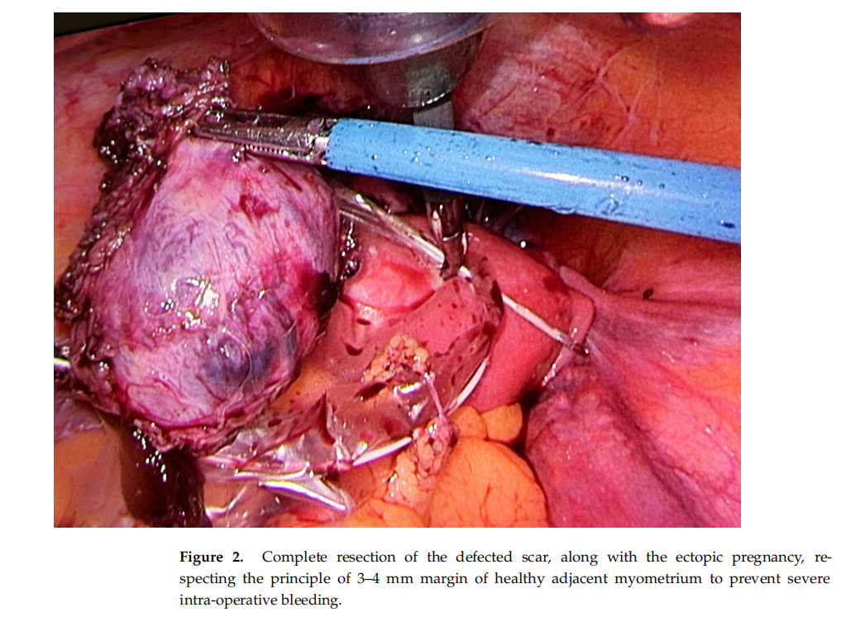

Slide 19
Discussion
there is a lack of clear guidelines or algorithms for the management of CSP

Slide 20
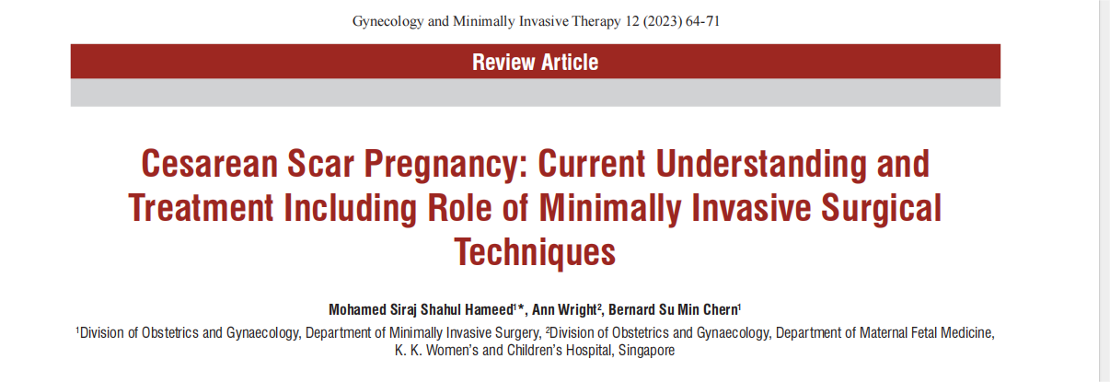
algorithm

Slide 21
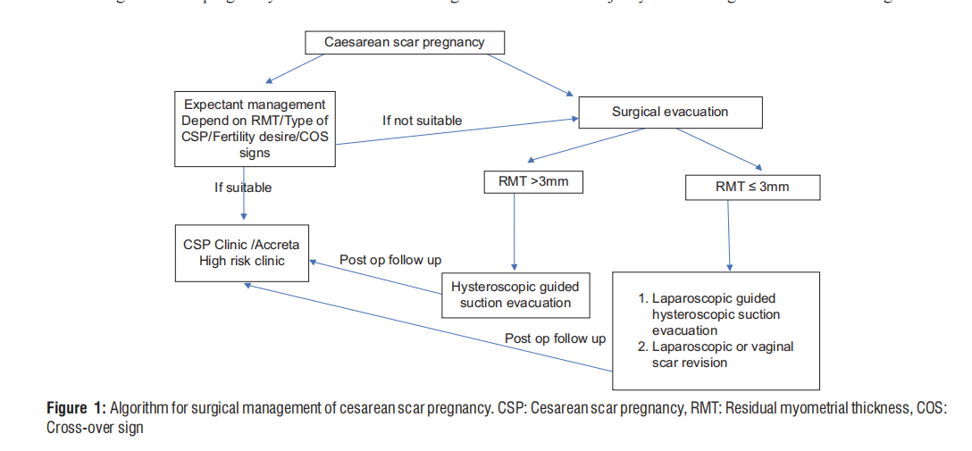

Slide 22
laparoscopic managmengt
The laparoscopic management of CSP is gaining more and more interest as a fertility_x0002_preserving surgery.
This approach seems to be associated with high success rate, lowcomplication rate, shorter hospital stay and faster recovery time

Slide 23
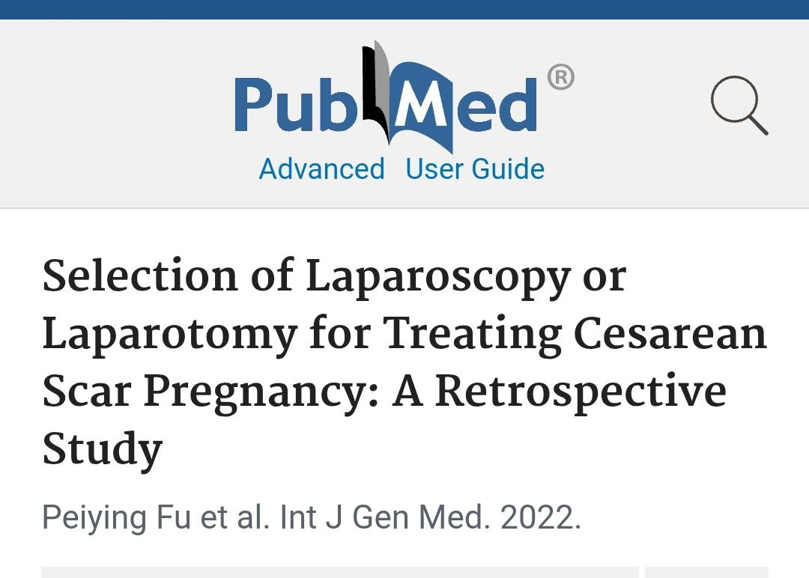

Slide 24
The use of sub-serosal injection of vasoconstrictors such as vasopressin before uterine incision
associated with severe adverse events such as bronchospasm, bradycardia,pulmonary oedema and even cardiac arrest
the time limited effect of vasoconstrictor agents or other temporary vascular strategies might temporarily mask an intra-operative bleeding.

Slide 25
perform a safe uterine artery clamping??
have advancedsurgical skills and deep knowledge of the retroperitoneal anatomy.
The identification and isolation of the uterine artery from the surrounding structures is often challenging especially in the context of hypervascularised gravid uteri.
This surgical step lengthens the
operating time and may increase the risk of severe hemorrhage as well as mechanical or thermal ureteral injury

Slide 26
For all the above listed reasons, we adopted the laparoscopic management of CSP
as a simplified therapeutic approach without being combined with any other strategy or
vascular pretreatment

Slide 27
laparoscopic management seems to be an appropriate fertility-preserving approach for the treatment of CSP when performed by skilled laparoscopic surgeons.
It can be safely proposed as a single and effective therapeutic approach
without being combined with any other strategy or vascular pretreatment.

Slide 28
Larger series and further prospective studies are required to confirm this observation and to affirm thelong-term gynecological and obstetrical outcomes of this management

Slide 29
Thank you

