Slide 1
Interventions for non-tubal ectopic pregnancy
Presented by: Dr. Marjan Ghaemi

Slide 2
B A C K G RO U N D
Non-tubal ectopic pregnancy is the implantation of an embryo at a site lying outside the uterine cavity or fallopian tubes.
Sites include a caesarean scar, the cornua uteri, the ovary, the cervix, and the abdomen.
There has been an increasing trend in the occurrence of these rare conditions, especially caesarean scar pregnancy (CSP), which poses a diagnostic and treatment challenge for clinicians
The incidence of non-tubal ectopic pregnancy is estimated at 5.0% to 8.3% of all ectopic pregnancies, while the incidence of ectopic pregnancy is estimated at about 1% to 2% of all pregnancies

Slide 3
complications
Although relatively uncommon, these conditions are responsible for serious immediate and delayed complications, with significant hemorrhages and a high rate of maternal fatality
Ectopic pregnancy makes up 80% of maternal deaths that occur in the first trimester, of which non-tubal ectopic pregnancy deaths account for a higher rate than tubal pregnancy deaths.
Thus, it is important to recognize that the implantation site of ectopic pregnancy affects the severity of the condition and early diagnosis and effective treatment are essential to reduce the immediate and delayed adverse effects, and to avoid significant maternal morbidity and mortality.

Slide 4
CSP
CSP has increased because of the increased rate of caesarean sections performed and may account for up to 6.1% of all ectopic pregnancies in women with a history of at least one caesarean section.
The criteria for ultrasonography diagnosis include: (i) no fetal parts observed in the uterine cavity or cervical canal; (ii) a gestational sac located in the anterior part of the isthmic portion separated from the endometrial cavity or fallopian tube; (iii) a gestational sac embedded within the myometrium and the fibrous tissue of the caesarean section scar with diminished healthy myometrium between the bladder and the sac; and (iv) high velocity with low impedance blood flow surrounding the gestation sac
CSP typing according to direction of growth of the gestational sac and thickness of the myometrium between the bladder and gestational sac has been proposed, and three types (I, II, and III) were divided as different ultrasonic manifestations.

Slide 5
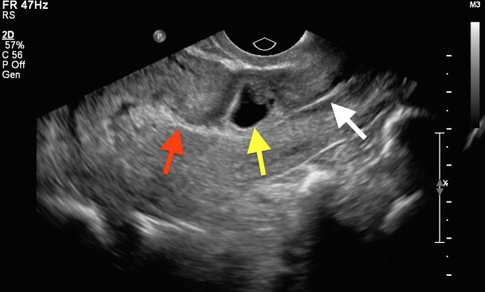
Longitudinal grayscale transvaginal ultrasound obtained with a MHz transducer shows an anteverted, anteflexed uterus. The uterine cavity (red arrow) and cervical canal (white arrow) are empty. There is a gestational sac (yellow arrow) in the anterior myometrium of the lower uterine segment, with marked thinning of

Slide 6
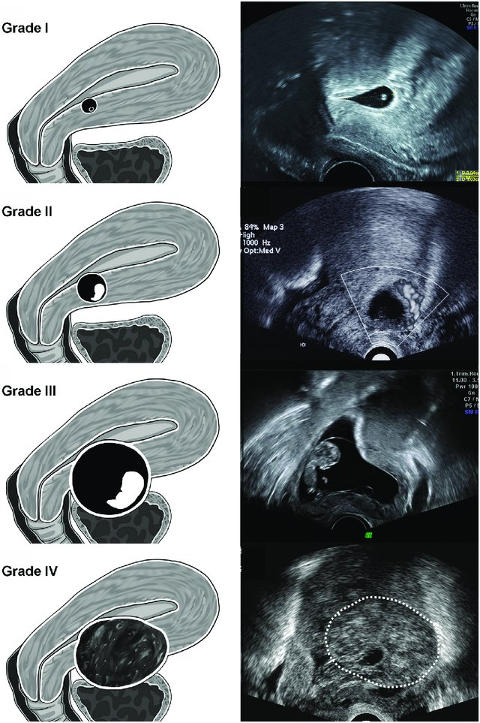
The description of our new ultrasound grading system for CSP. Grade I CSP represented the depth of CSP embedded in less than one-half thickness of the lower anterior corpus. Grade II CSP implied CSP occupied more than one-half thickness of the lower anterior corpus. In grade III CSP, the GS bulged out the overlying myometrium and uterine serosa. In grade IV CSP, the GS became an amorphous tumor with rich vascularity at the cesarean scar.

Slide 7
Ovarian pregnancy
Ovarian pregnancy accounts for 1% to 6% of all ectopic pregnancies.
Ovarian pregnancy is often confused with corpus luteum cysts.
Ultrasonography examination is routinely required and laparoscopy often plays a key role in diagnosis, with confirmation by pathological examination of removed tissue. The criteria are as follows: (i) empty uterine cavity; (ii) tubes entirely intact, separated from the ovary; (iii) a gestational sac located at the normal position of the ovary;
(iv)ovary and a gestational sac connected to the uterus by the ovarian ligament; and (v) trophoblastic tissue attached to the ovarian cortex in the tissue specimen.

Slide 8
Ovarian ectopic pregnancy. Transvaginal ultrasound showing a gestational sac located within the ovarian stroma (white arrow)

Slide 9
Cornual pregnancy
Cornual pregnancy has a prevalence of 1.7% to 2.1% of all ectopic pregnancies.
The term cornual pregnancy is often used interchangeably in the literature with interstitial pregnancy, but it actually refers to a pregnancy located in the interstitial portion of a unicornuate or bicornuate uterus.
The diagnosis can be made by the following ultrasonography criteria: (i) a single interstitial portion of a fallopian tube in the main uterine body; (ii) a mobile gestational sac surrounded by myometrium but separated from the uterus; and (iii) a vascular pedicle adjoining the gestational sac to the unicornuate uterus.

Slide 10
Interstitial ectopic pregnancy: presence of an eccentric gestational sac with myometrial tissue that surrounds the gestational sac with a thickness of 2 mm

Slide 11
Cervical pregnancy
Cervical pregnancy is a rare form of ectopic pregnancy with an estimated frequency of less than 1% of all ectopic pregnancies.
Cervical pregnancy can be diagnosed by the following ultrasonography presentations: (i) empty uterine cavity; (ii) dilated or barrel-shaped cervix; (iii) a gestational sac within the mucosa located in the endocervical canal; and (iv) a sliding sac sign.

Slide 13
Abdominal pregnancy
Abdominal pregnancy is one of the rarest forms of ectopic gestation and occurs in 0.3% to 1.4% of all ectopic pregnancies.
It refers to a gestational sac implanted in the omentum, abdominal vital organs, or large vessels, and is described as either primary or secondary.
A primary abdominal pregnancy is due to a failure of the fimbria to pick up the ovulated follicle, while a secondary abdominal pregnancy is believed to follow early rupture or abortion of a tubal pregnancy or uterine perforation of a intrauterine pregnancy into the peritoneal cavity.
The following criteria have been suggested to diagnose abdominal pregnancy: (i) empty uterine cavity; (ii) absence of a dilated fallopian tube and a complex adnexal mass; (iii) absence of myometrial tissue between the bladder and pregnancy; (iv) a gestational sac surrounded by intestinal tissue and separated by the peritoneum; and (v) a free mobility similar to fluctuation of the sac

Slide 14
Diagnosis And Treatment
The diagnosis of, and treatment for, non-tubal ectopic pregnancy are challenging and frequently constitute a medical emergency.
Thus, prompt and effective treatment is important to avoid potentially catastrophic consequences such as massive haemorrhaging, hysterectomy, and death.
The improved ultrasonography technology widely used in early pregnancy assessment and high awareness of the possibility of ectopic pregnancy have contributed to earlier diagnosis of these pregnancies.
This has led to advances in their management, aiming to limit morbidity and to preserve the uterus and subsequent fertility.
Although many treatment options have been recommended, the optimal treatment is yet to be clarified.

Slide 15
Surgery
Surgery is the primary treatment for most ovarian, cornual, and abdominal pregnancies.
Management of ovarian pregnancy usually requires ovariectomy or ovarian wedge resection. Ovarian wedge resection may be considered by women with future fertility in mind, whereas ovariectomy is limited to cases of advanced gestation.
Cornual pregnancy has traditionally been treated using cornual resection or hysterectomy in the cases with severely damaged uteri.
The surgery can be completed through laparoscopy or laparotomy, but laparotomy may be required for women with uterine rupture and haemoperitoneum.

Slide 16
Surgery
In abdominal pregnancy surgical management with ligation of the placental blood supply and removal of some early abdominal pregnancies implanted on a less vascular surface can be managed by laparoscopy.
In advanced pregnancies, selective arterial embolization is necessary before surgery to avoid hemorrhage.
For cervical and caesarean scar pregnancies, laparotomy and hysterectomy may be required for more advanced pregnancies.

Slide 17
Medical treatment
For women who desire fertility preservation, conservative measures have become the first-line approach. These options include administration (local or systemic) of various chemotherapeutic agents (including methotrexate (MTX), etoposide, actinomycin D, and cyclophosphamide) and endoscopic removal techniques (laparoscopy or hysteroscopy), alone or as adjuvant therapies, with or without haemostatic techniques (balloon tamponade, uterine artery ligation, cerclage, and cervical stay sutures).
With cervical pregnancies before 12 weeks' gestation where the women have lower serum β-human chorionic gonadotropin (β-hCG) levels and no fetal cardiac activity, it may seem reasonable to administer conservative treatment. Systemic MTX administration is a common approach to cervical pregnancy and has high efficacy, but it may be associated with increased risk of primary failure for pregnancies greater than nine weeks' gestation, with β-hCG levels above 10,000 mlU/ mL, crown–rump length greater than 10 mm, and fetal cardiac activity.

Slide 18
Treatments
Suction curettage with balloon tamponade or uterine arterial embolization (UAE) may be a choice for first trimester cervical pregnancy.
Local or systemic injection of chemotherapy has met with various degrees of success for treatment of CSP.
Advances in UAE have enabled a minimally invasive approach in these women. Dilation and suction curettage can be used after chemotherapy but should not be the first-line approach in cervical and CSP because of the risk of perforation and catastrophic haemorrhage.
Medical management with MTX has been reported for ovarian pregnancy but may not be practical.
Conservative measures may be attempted for selective cornual pregnancies but carry a high risk of initial failure.
Systemic MTX chemotherapy and ultrasonography-guided injection of potassium chloride for management of early abdominal pregnancies has been reported.
Expectant management does not seem to be an appropriate choice for most cases and may be only suitable for women with declining β-hCG levels and absence of fetal cardiac activity.
However, women should be closely monitored in case the lesion ruptures or the situation deteriorates.

Slide 19
UAE
UAE involves blocking the arteries using gelatin beads or other materials. It has been used as an adjuvant therapy to prevent excessive haemorrhage before uterine surgery or curettage procedures.
Bilateral uterine arterial chemoembolization (UACE) is a combination of arterial embolization and local administration of chemotherapy. During the procedure, MTX is delivered directly into the gestational foci via the bilateral uterine arteries, which provide the blood supply.
Then occlusive agents are injected in to the delivery catheter to block the blood vessels. The procedure uses both chemotherapy and tissue ischaemia and thus uses a higher concentration of MTX leading to more effective embryocide, with fewer systemic toxic effects and reduced haemorrhage.
As a minimally invasive treatment, it has been considered as a conservative method for treating CSP.

Slide 20
Methods
Types of studies
RCTs that compared one treatment with another in the management of non-tubal ectopic pregnancy, in all languages. The allocation to either treatment was by random allocation.
Types of participants
Women of childbearing age with a diagnosis of caesarean scar, abdominal, cornual, cervical, or ovarian pregnancy.
Types of interventions
We made comparisons of surgery or medical treatment versus expectant management, and surgery versus medical treatment, subgrouped by location of pregnancy and specific type of intervention.

Slide 21
Medical treatment
Primary outcomes
Treatment success (success after initial treatment) - defined as an uneventful decline of serum hCG to undetectable levels by the initial treatment. Also defined as 'a steady decline in serum β-hCG to normal levels by the initial treatment, coupled with a lack of major complications (including massive acute bleeding, recurrence of active bleeding, incomplete abortion and hysterectomy)'.

Slide 22
Adverse effects (blood loss, fever, nausea and vomiting, stomatitis, alopecia, pneumonitis, abdominal or pelvic pain, leukopenia, and abnormal liver or renal function).
• Time to normalize β-hCG.
• Hospital stay.
• Financial costs.
• Future fertility (restoration of normal menstrual cycles,repeat ectopic pregnancy).

Slide 23
Results
1. Surgery alone or surgery plus medical treatment versus medical treatment alone (prior to suction curettage)
1.1. Caesarean scar pregnancy
1.1.1 UAE/UACE versus systemic MTX (prior to suction curettage)
Two studies reported treatment success after initial treatment (defined as an uneventful decline of serum β-hCG to undetectable levels by the initial treatment) between UAE and systemic MTX.
We are uncertain whether UAE/UACE improved treatment success after initial treatment.
Two studies reported rates of complications (heavy bleeding, recurrence of active bleeding, and hysterectomy) between UAE and systemic MTX.
We are uncertain whether UAE/UACE reduced rates of complications.

Slide 24
Adverse Effects
One study comparing UAE with systemic MTX reported rates of adverse effects (UAE: including fever and pain and one readmitted woman; MTX group: including abnormal liver function and severe vomiting).
The other study compared rates of adverse effects (mild increase in liver enzymes, mild vomiting, and moderate abdominal or pelvic pain) between UACE and systemic MTX.
We are uncertain whether UAE/UACE reduced adverse effects.

Slide 25
Adverse Effects
Blood loss Two studies comparing UAE /UACE with systemic MTX reported blood loss.
It was lower in the UAE/UACE groups than in the systemic MTX groups.
Time to normalize β-hCG
No study reported this outcome.

Slide 26
Results
Surgery plus medical treatment versus medical treatment alone
2.1. Caesarean scar pregnancy
2.1.1 UACE plus MTX versus ultrasonography-guided local MTX injection
Primary outcomes
One study reported treatment success after initial treatment (defined as an uneventful decline of serum β-hCG to undetectable levels by the initial treatment).
We are uncertain whether UACE improved treatment success after initial treatment compared with local MTX injection.

Slide 27
3. Surgery versus another surgery
3.1. Caesarean scar pregnancy
3.1.1. Suction curettage under hysteroscopy versus under ultrasonography after UAE/UACE
Two studies reported treatment success after initial treatment (defined as an uneventful decline of serum β-hCG to undetectable levels by the initial treatment.
We are uncertain whether suction curettage under hysteroscopy improved treatment success after initial treatment compared with under ultrasonography.
One study reported rates of complications including heavy bleeding, recurrence of actively bleeding, pelvic infection, and hysterectomy.
The other study reported rates of complications including heavy bleeding, uterine perforation, pelvic infection, incomplete abortion, and uterine adhesion.
We are uncertain whether suction curettage under hysteroscopy reduced rates of complications after UAE(Qian 2015) or UACE(Li 2016) compared with under ultrasonography.

Slide 28
Discussion
The included studies partially answered the review question.
We found few studies meeting our criteria, and among them, results showed a lack of consistency in methods of interventions and outcome measures, which leads to difficulties in combining data in a suitable meta-analysis, thus making it difficult for review authors to draw clinically relevant conclusions.
Before suction curettage, UAE/UACE showed less blood loss than systemic MTX, but more evidence is needed.
As all the included studies were conducted in China, we consider there could be a specific concern about generalization of the results.

Slide 29
Conclusion
It is uncertain whether there is a difference in success, complications, and adverse effects between UAE/UACE and administration of systemic MTX before suction curettage (low-quality evidence).
Blood loss may be lower if suction curettage is conducted after uterine arterial embolization (UAE)/uterine arterial chemoembolization (UACE) than after administration of systemic methotrexate (MTX) (moderate-quality evidence).
It is uncertain whether there is a difference in success, time to normalize β-hCG (low-quality evidence), complications, or adverse effects (very low-quality evidence) between suction curettage under hysteroscopy and under ultrasonography.

