Slide 1
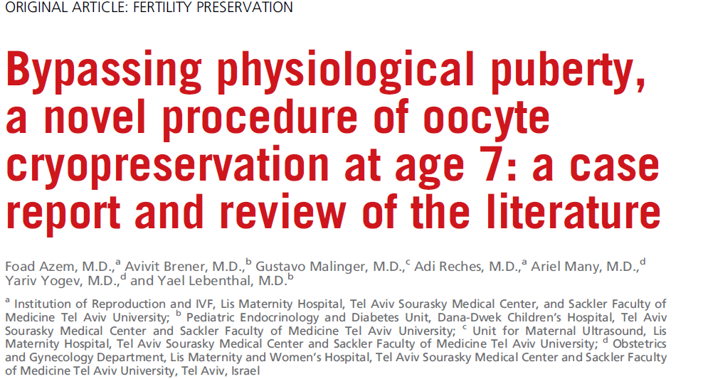
Fertility and Sterility, Volume 114, Issue 2, August 2020, Pages 374-378

Slide 2
Dr. Maryam Razavi
Fellow of infertility
Tehran university of medical science (TUMS)
Imam Khomeini complex hospital

Slide 3
Fertility preservation
embryo cryopreservation
oocyte cryopreservation
ovarian tissue cryopreservation
in vitro maturation

Slide 4
Turner syndrome
25 to 50 cases per 100,000 females
increased risk of hypergonadotropic hypogonadism
primary or secondary amenorrhea accompanied by infertility
premature ovarian insufficiency
rate of oocyte depletion cannot be predicted

Slide 5
Case Presentation
A 7-year-old girl
with Turner syndrome (45,X/47,XXX mosaicism)
who underwent fertility preservation
by controlled ovarian hyperstimulation and oocyte cryopreservation
after a transabdomina retrieval approach
that yielded six mature oocytes

Slide 6
MATERIALS AND METHODS
A 6.7-year-old patient
Assessed of Ovarian reserve

Slide 7
Fertility counseling and preservation discussions: a multidisciplinary approach

Slide 8
First cycle of Controlled ovarian stimulation and oocyte retrieval
daily injections of 75 IU of recombinant human FSH and 37.5 IU of recombinant human LH per milliliter
day 8
day 10
Subcutaneous injection of 0.2 mg of the low-dose gonadotropin-releasing hormone agonist triptorelin acetate
pickup after 36 hours
Unfortunately, the ovum pickup revealed empty follicles
corpus luteum function was not assessed

Slide 9
second cryopreservation cycle
Forty days after
daily administration of 100 IU Pergoveris
Day 8
250 mg of recombinant human chorionic gonadotropin
pickup after 36 hours
The follicular aspiration procedure was performed as in the first cycle

Slide 10
RESULTS
Six oocytes were retrieved
all were mature metaphase 2

Slide 11
DISCUSSION
bypasses the progression of pubertal maturation of the hypothalamic-pituitary-ovarian axis
The partial or complete loss of the X chromosome is detrimental to the developing ovary
estimate the ovarian reserve
Fertility preservation for cancer patients

Slide 12
CONCLUSION
Induction of oocyte maturation
from prophase I to MII
Of meiosis
in a prepubertal girl
is feasible
after a short course of ovarian stimulation
with recombinant gonadotropins (FSH and LH) and hCG

Slide 13
The ovaries are dynamic organs that evolve in a gonadotropin-dependent manner from birth to maturity.

Slide 14
The ovaries are dynamic organs that evolve in a gonadotropin-dependent manner from birth to
maturity.

Slide 15
gonadotropin-releasing hormone-agonist to induce oocyte maturity highlights that the hypothalamic-pituitaryovarian axis was inactive.
Ovarian development in fetuses with Turner syndrome is characterized by accelerated follicular atresia beginning in the second trimester

Slide 16
spontaneous pregnancies and live births have been reported
The timing of fertility preservation is guided by a combination of karyotype, age, serum markers
(FSH and AMH levels), and antral follicle count

Slide 17
this procedure is not suitable for all Turner syndrome patients. Most girls with 45,X monosomy
Have complete oocyte depletion by the first few months of life

Slide 18
Cancer:
ovarian tissue preservation is contraindicated in patients with leukemia who are at risk of microscopic metastases
Turner
the hormone milieu of Turner syndrome patients and prepubertal patients with cancer
is very different. Varying gonadotropin levels and early elevation of estradiol levels in Turner syndrome patients (15, 22) indicate that there may be early activation of the hypothalamic-pituitary-ovarian axis with ovarian priming in Turner syndrome patients that does not occur in 46,XX females at a similar age

Slide 19
Previous case report on premenarchal girl (Reichman et al.)
girl with T13-year-old premenarcheal tanner stage 3
Applied transvaginal ultrasound-guided aspiration rather than transvaginal.

