Slide 1
Frozen embryo transfer: a review on the optimal endometrial preparation and timing
By A. Tarafdari

Slide 2
Introduction
More efficient cryopreservation strategies (i.e. vitrification) and reassuring safety data have progressively increased the use of frozen embryo transfer (FET)
The use of an antagonist protocol with agonist triggering followed by a ‘freeze all’ strategy and transfer of the embryo(s) in a subsequent FET cycle is a promising option with high live birth rates .
Its use has now been also extended to cycles with pre-implantation genetic diagnosis/screening, latefollicular progesterone elevation and embryo-endometrial asynchrony
Moreover, there is an ongoing debate whether frozen embryos transferred in a ‘more physiologic’ non-stimulated endometrium, may not only result in higher pregnancy rates but also potentially decrease maternal and neonatal morbidity.

Slide 3
FET preparation methods
FET preparation methods can largely be divided into :
Artificial (HRT) cycle
Natural cycles (NCs)

Slide 4
Hormonal replacement treatment Estrogen supplementation
Most HRT protocols empirically opt to supplement estrogens for 2 weeks in an attempt to mimic the NC.
However, it seems that such an extended period may be unnecessary and that 5–7 days may suffice for adequate endometrial proliferation.
Caution, however, is warranted, given that a higher miscarriage rate with shorter estrogen supplementation has also been previously reported .
Conversely, if necessary, estrogen supplementation may also be safely prolonged without compromising pregnancy outcome.

Slide 5
Route of Administeration
Estrogens may be administered orally, vaginally and transdermal route and both natural as well as synthetic estrogens may be used.
A meta-analysis concluded that the type of estrogen supplementation and route of administration had no effect on the success rates of FETs.

Slide 6
The conversion between different supplementation methods
0.75 mg of micronised estradiol (oral administration) = 1.25 g of estradiol gel (transdermal administration) = 1 mg of estradiol valerate (oral or vaginal adminstration).
The standard dose of estradiol valerate is 6 mg daily.

Slide 7
GnRH agonist
. Besides the administration of estrogen, a GnRH agonist can be added to a HRT protocol in order to prevent spontaneous ovulation .
In one randomized controlled trial (RCT), the use of such an approach was associated with increased clinical pregnancy and live birth rates, mainly due to lower cycle cancellation rates .
The results of this trial are also in contradiction with those of subsequent systematic reviews and metaanalyses, which failed to demonstrate any benefit in terms of clinical pregnancy and cancellation rates .
Conversely, HRT FET cycles without GnRH agonist co-treatment seem to be more patient-friendly given the avoidance of the cost and potential side effects associated with these drugs.

Slide 8
Progesterone supplementation.
Orally
Vaginally
Intramuscular
Subcutaneous

Slide 9
Natural cycle
In a NC FET, there is no medical intervention, except of endocrine and ultrasound monitoring during the proliferative phase.
Although the advantage is the absence of estrogen supplementation, this protocol entails more frequent visits to the clinic, less cycle control and flexibility and holds a higher risk of cycle cancellation.

Slide 10
Proliferative phase monitoring
NC can either be triggered exogenously (i.e. modified NC, in which ovulation is triggered by hCG as soon as a dominant follicle of e.g. >16 mm is observed)
or by serial blood (or, albeit less accurately, urine) sampling until a LH peak is observed (i.e. true NC, in which ovulation occurs spontaneously).
Spontaneous versus triggered ovulation.
Progesterone supplementation.

Slide 11
HRT or NC?
Data have left physicians with conflicting information in terms of clinical outcome.

Slide 12
FET Timing
It seems that the starting day of progesterone intake is optimal when equal to the theoretical day of OR or 1 day later.
This presumptive embryo transfer timing is in parallel with the timing of fresh embryo transfer after OR: the day of starting progesterone supplementation (considered as P + 0) is set equal to the theoretical day of OR, which is indeed also Day 0 from an embryonic point of view.

Slide 13
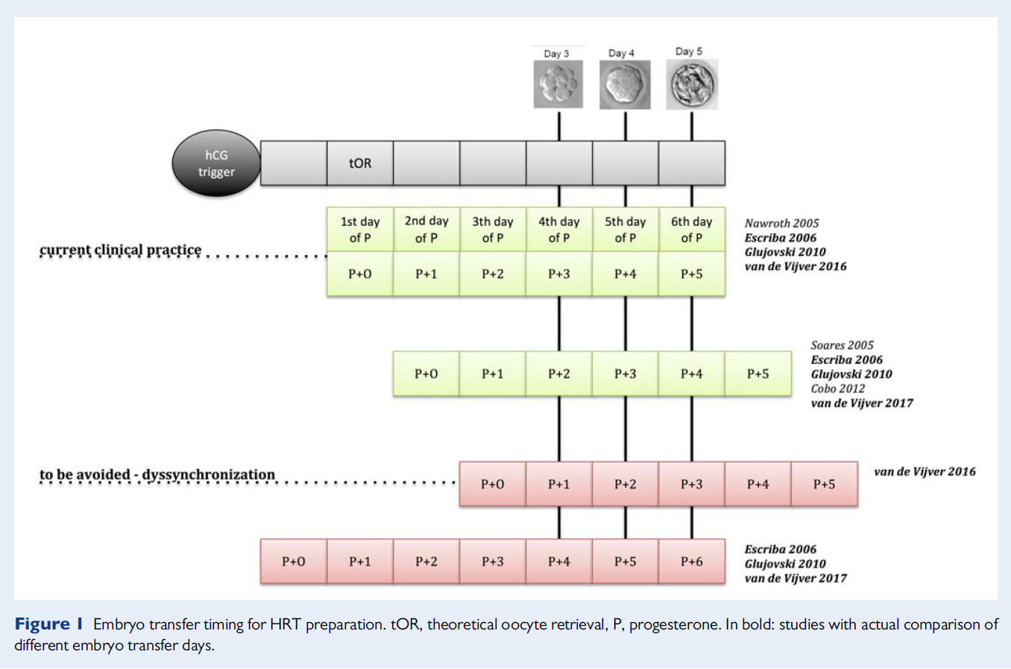

Slide 14
Natural cycle
In a NC, the WOI is posited to open 6 days after the postovulatory progesterone surge and thought to last ~2–4 days (LH+ 7 to LH+ 11).
When using the LH surge to plan embryo transfer one must take into account that the LH surge can occur over a period of 30 h .
Progesterone rises slightly to 1–3 ng/ml even 12 h to 3 days prior to ovulation, due to the LH-stimulated production by the peripheral granulosa cells , with a steep increase in production following ovulation (3–10 ng/ml) due to production by the corpus luteum.

Slide 15
A difference in the timing of FET in true versus modified NC could be considered, as ovulation occurs 36–48 h after hCG administration but varies from 24 to 56 h after a spontaneous LH surge.
For intra-uterine insemination, it has been shown that pregnancy rates are higher when it was performed 36–42 h after hCG trigger, but 18–24 h after spontaneous LH surge.
One could draw the parallel to FET and transfer 1-day earlier when a spontaneous LH surge is detected in the serum compared to when ovulation is triggered with hCG.

Slide 16
FET timing proposal
− In HRT:
On day (embryonic age + 1) of progesterone administration, annotated
as P+ embryonic age (e.g. a Day 5 embryo on the 6th day of progesterone
administration, annotated as P + 5).
− In a modified NC (with hCG trigger):
On day (embryonic age + 2) after hCG injection (e.g. a Day 5 embryo
on hCG + 7).
− In a true NC (with spontaneous LH surge):
On day (embryonic age + 1) after LH surge (e.g. a Day 5 embryo on
LH + 6).

Slide 17
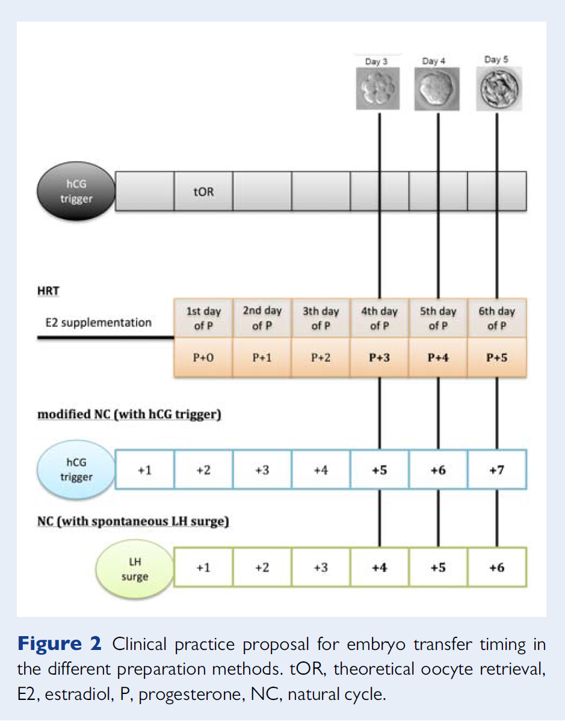

Slide 18
Specific attention is warranted in situations where embryo thawing is
followed by further in vitro culture and embryonic development prior
to transfer. In such cases, it is likely better to take into account the
expected embryonic stage at the moment of transfer instead of the
stage in which the embryo was cryopreserved.

Slide 19
Thanks for your attention

